Slide 1

Introduction to
Enterprise Content Management
and
Alfresco ECM

Slide 2
Table of Contents
ECM Overview
Alfresco Overview
Alfresco Digital Business Platform
Alfresco ADF
Alfresco Content Services
Alfresco Content Services – Capabilities and Modules
Alfresco Process Services
Technologies Used

Slide 3
ECM Overview - Definition
What is ECM?
As per AIIM ( Association for Information and Image Management ), Enterprise content management (ECM) is a formalized means of organizing and storing an organization's documents, and other content, that relate to the organization's processes. The term encompasses strategies, methods, and tools used throughout the lifecycle of the content.
ECM is not a single system. Its a group of aligned systems.
ECM is more about managing semi-structured and unstructured information.
3

Slide 4
ECM Overview - Types of Information
Structured Information | Unstructured information | Semi-structured information
This information is highly defined and can be processed directly by computer programs such as data held in RDBMS. | This information does not have a fully defined structure, and most likely will be read and used by humans, such as images, word documents, video, audio, etc | This information lies somewhere in between, like invoices, purchase orders, and receipts, which contain data to be computer-processed but which come in formats and layouts that first need to be identified and classified – a task that often is handled by humans but increasingly is being automated as the tools improve.

Slide 5
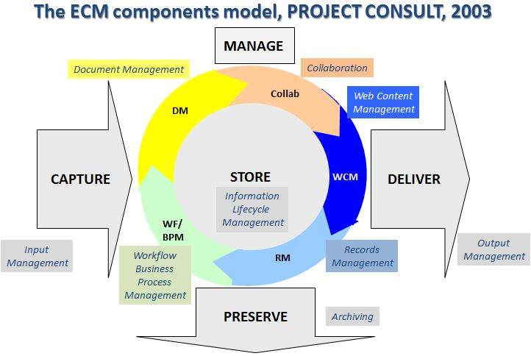
ECM Overview - Components
There are five basic components of ECM
Capture
Manage
Store
Preserve
Deliver
5

Slide 6
ECM Overview – Why ECM?
Improve Productivity and Efficiency
Reduce Operational Costs
Improve security
Easily find and search documents
Dealing with different versions of documents
Regulatory compliance requirements
Speed up business process
Managing paper documents
6
Notes:
Improve Productivity and Efficiency: An organisation’s documents can be strewn all over the place, in filing cabinets, on someone’s desktop or laptop, in email or on a central server. As a result, employees can waste enormous amounts of time searching for misfiled documents and lost data. Knowing where to find a document in its most current version can save an organisation precious time and money.
Reduce Operational Costs: The costs associated with creating, storing, searching for, retrieving, printing and copying files are growing at a phenomenal rate. Beyond the sizable labor costs related to handling and maintaining paper documents, hard copy storage also incurs ongoing material expenses. Printing and copying do not disappear entirely in a paperless environment, but when paper no longer constitutes the primary medium for information storage and distribution, an organisation prints and copies significantly less.
Improve security: By limiting access to certain documents, you can improve regulatory compliance and security.
Easily find and search documents: The system can index captured documents and assign a unique ID to every document - for easy storage.
Dealing with different versions of documents:
Regulatory compliance requirements: Meet regulatory compliance requirements for manage, audit and archive.
Speed up business process: Speed up the movement of documents between different users and flexible as per organization process.
Managing paper documents: Manage paper documents such as receipts, invoices, workorders, etc and extract information from it.

Slide 7
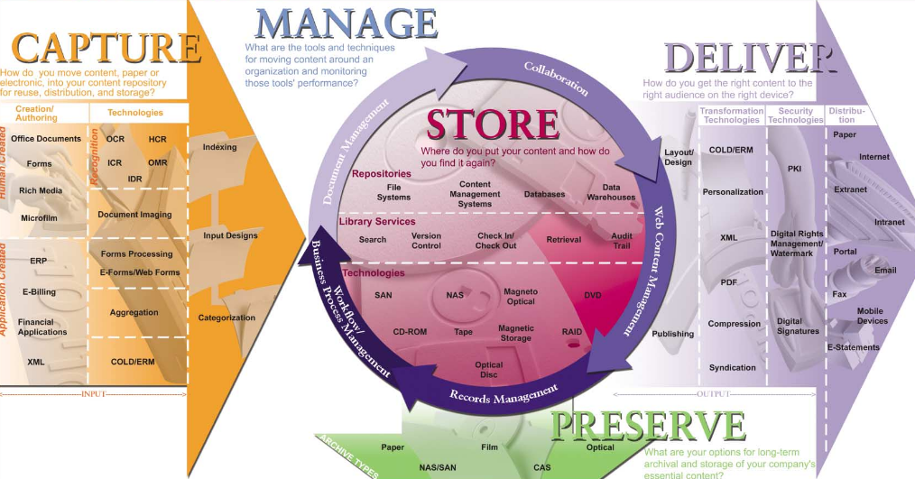
ECM Overview – Components Overview
7
Notes:
Capture
Capture is converting paper format documents to electronic format or collecting electronic files and information into a consistent structure for management.
Caputure automation involves
Scanning and Recognition
Document Imaging
Forms Processing
Indexing
Manage
Manage category is broadly divided into five application areas.
Document management (DM)
Collaboration
Web content management (including Web portals)
Records management
Business process management (BPM)
Store
Content will be stored in any of the storage media for rapidly accessing it.
Store components are divided into three categories:
Repository – storage locations (File systems, CMS, Databases, etc)
Library services – access information from repository (checkin, checkout, version, etc)
Storage technologies – storage media (Magentic, Optical, Cloud, etc)
Preserve
Preserve involves the long-term, safe storage and backup of static, unchanging information. Preservation is typically accomplished by the records management features of an ECM system and many are designed to help companies comply with government and industry regulations.
Deliver
The deliver components of ECM present information from the Manage, Store, and Preserve components. The Deliver components break down into three groups:
Transformation technologies
Security technologies
Distribution

Slide 8
Alfresco Overview
Alfresco is an open source Enterprise Content Management (ECM) system.
It was originally created in 2005 by a team from Documentum and Oracle, as an open source alternative to proprietary vendors in ECM market.
Alfresco became the first sponsor of the open source BPM Engine called Activiti in 2010, and launched a commercial version of that product in 2014.
In 2017, Alfresco launched the Alfresco Digital Business Platform- connecting people, content, and processes seamlessly, and allowing customers to rapidly develop new applications and very easily integrate content and process services with other systems through our open API’s.
Alfresco provides tools that allow us to deploy solutions either on-prem, or on the cloud, hybrid.
8

Slide 9
Alfresco Overview
Alfresco One is an Enterprise Content Management (ECM) platform with hybrid, on-premise, cloud, and mobile delivery options.
Alfresco is an enterprise content platform that can be used in the cloud or behind the firewall.
With Alfresco document management, collaboration, and process automation can be synced to the cloud enabling secure collaboration outside of the firewall.
9

Slide 10
Alfresco DBP
Alfresco Digital Business Platform
Application Development Framework
Integrations / Extensions
Open APIs and Open Standards
Alfresco Process Services
Alfresco Content Services
Alfresco Governance Services
Intelligence and Analytics
On-Prem, Cloud, Hybrid, Managed
10
Notes:
And that’s precisely what we deliver in our new Digital Business Platform:
A set of core services around process, content and governance
Exposed via open APIs and standards to become a platform that others can build upon
With out of the box integrations and extensions into existing end user tools you may have such as Office365, Google’s G-Suite or apps like Salesforce so that users do not have to Alt+tab out of where they are naturally working to leverage Alfresco services
On top of which we provide a new Development Framework that allows you to rapidly build bespoke user experiences.
We’ve also put in a rock-solid foundation for intelligent search and analytics to provide insight into your processes and content
And because we are full-stack thinkers… we give you guidance and tools to help your DevOps teams rapidly deploy (and update) new solutions

Slide 11
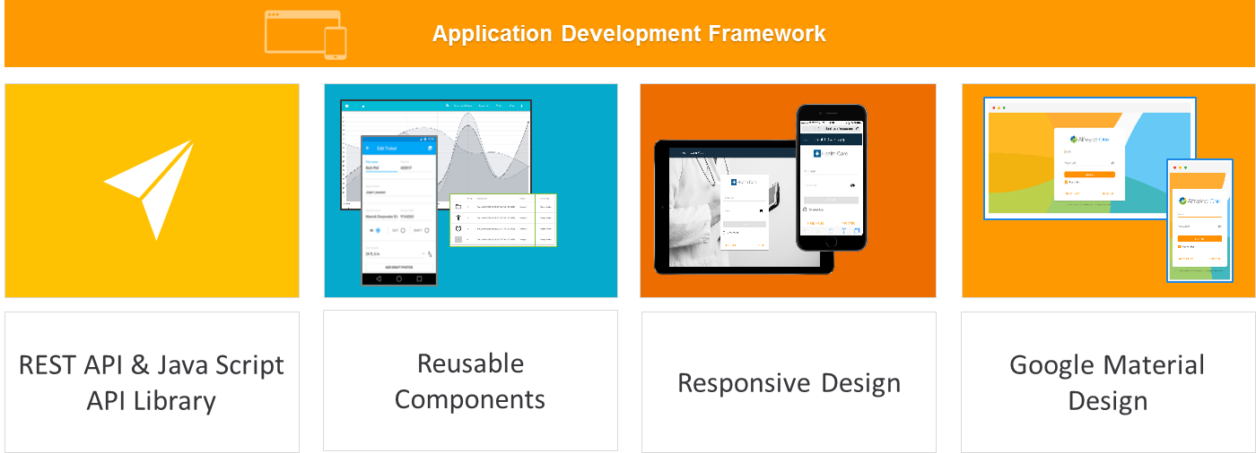
Application Development framework
Notes:
Application Development Framework is a client-side App Dev framework uses Angular2 to provide a wide range of highly configurable, re-useable content and process service components based on Google Material design.
ADF provides a unified experience for building business solutions that use the Alfresco Platform’s tightly integrated process, content and governance services.
Alfresco provides ADF artifacts utilizing Yeoman generators which quickly create an Application project with the required Services and components
Users have a consistent, engaging experience across mobile, web and desktop whether they’re using an Alfresco module or a custom application.

Slide 12
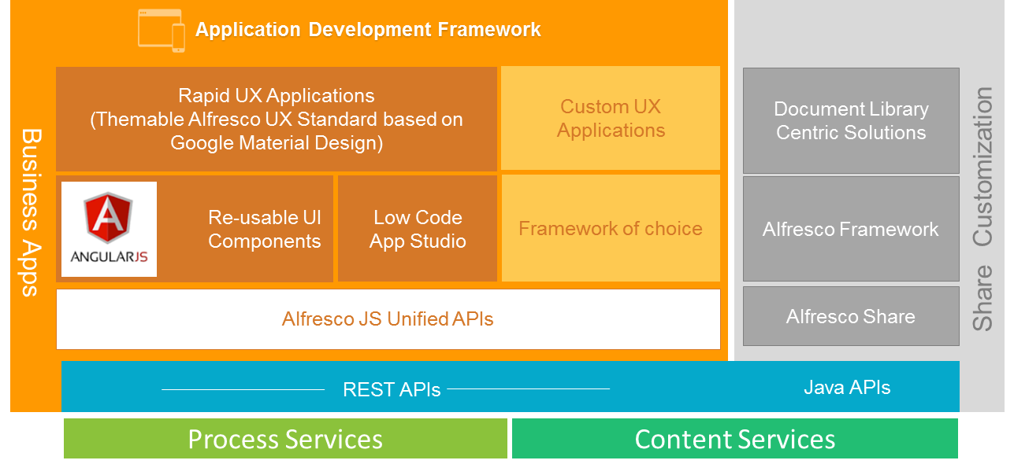
ADF - Architecture

Slide 13
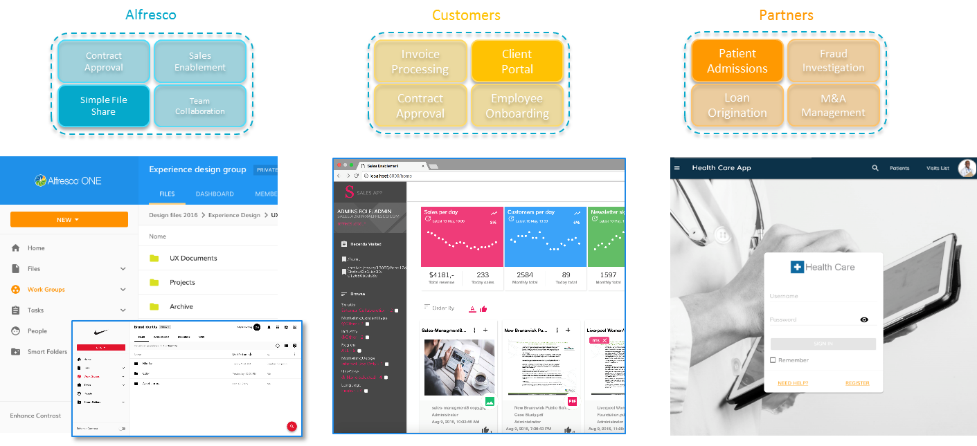
ADF - Examples

Slide 14
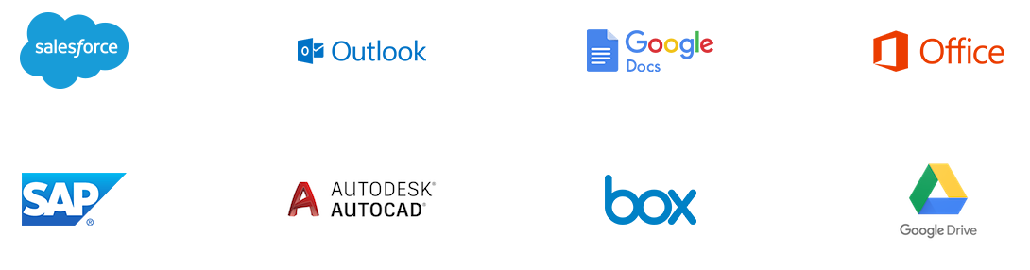
Open Standards, Open APIs and Extensions
Alfresco Platform has an open source core and fully embraces open standards, making it easy to integrate, extend and customize for specific industry needs
Unmatched support for open standards, including CMIS, CIFS and WebDAV
Public REST API for simple, easily maintained customization and process automation
Open at every level, including the repository, web interface, cloud and mobile apps
Alfresco works with Industry Leading applications to provide connectors.

Slide 15
Alfresco Content Services
Alfresco Content Services is flexible, highly scalable and open, ensuring content is accessible wherever and however you work and that it is easy to develop, integrate and extend.
Content Services
Application Development Framework
Integrations / Extensions
Open APIs and Open Standards
Capture
Lifecycle
Alfresco
Content Services
Document
Classification
Alfresco Process Services
Alfresco Content Services
Process Services
Relationship
Event
Transformation
Office
Index /Search
Security
Storage
Governance
Governance
Records
Audit
Marks
Holds
Intelligence and Analytics
On-Prem, Cloud, Hybrid, Managed
15

Slide 16
Alfresco Content Services – contd.
Edit Master text styles
Edit Master text styles
Edit Master text styles
Edit Master text styles
Open, easy to integrate and extend
Access & easily collaborate on content from anywhere
Brings content and processes together seamlessly
Information Governance simplified
Enterprise scale and security
Notes:
Open, easy to integrate:
Open source core with strong community
Easy to integrate and extend (Open Standards & API’s)
Add capabilities with connectors & add-ons
Access & easily collaborate on content from anywhere
Works with systems of engagement, including Microsoft Office, Google Docs and Salesforce
Rich collaboration features include team sites, discussion threads, project wikis
Desktop sync for offline access to content
Mobile apps (offline access, search and task review)
Securely work with partners via hybrid cloud sync
Brings content and processes together seamlessly
Rules, actions & scripting allow complex document processing without development overhead
Easily defined content data & relationship models
Auto- extraction of metadata, including smart document capture with Ephesoft
Extend to full featured BPM with Alfresco Process Services
Integrated analytics and reporting
Information Governance simplified
Full lifecycle capabilities including e-discovery, disposition and secure destruction
Centralized File Plan and Retention Policy manages records across legacy systems
Full audit trail on all actions for compliance
Security classification and marks provide an additional level of security beyond ACL’s
Enterprise scale and security
Scales to manage over one billion documents
Modular search, transformation, media encoding can all be scaled independently.
High availability architecture with simple clustering

Slide 17
ACS Capabilities
Desktop Sync
Search and discovery
Share and collaboration web access
Open Mobile Access
Office & Google Integration
Hybrid cloud sync
Flexible Data Model & Rules
Smart folders
Workflow
Information Capture & display
Security and Auditing
Easy Administration

Slide 18
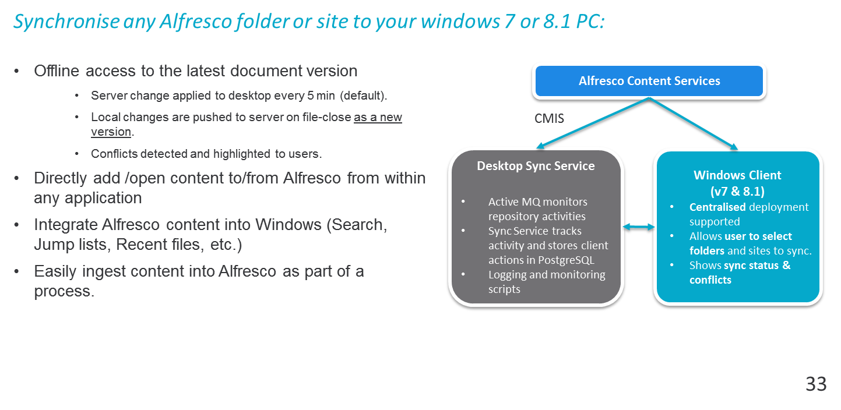
ACS Capabilities - Desktop Sync for Windows

Slide 19
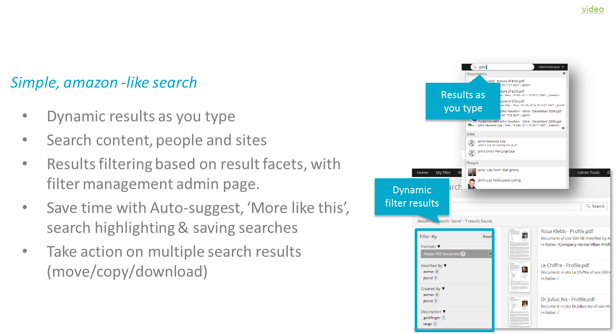
ACS Capabilities - Powerful Search & Discovery

Slide 20
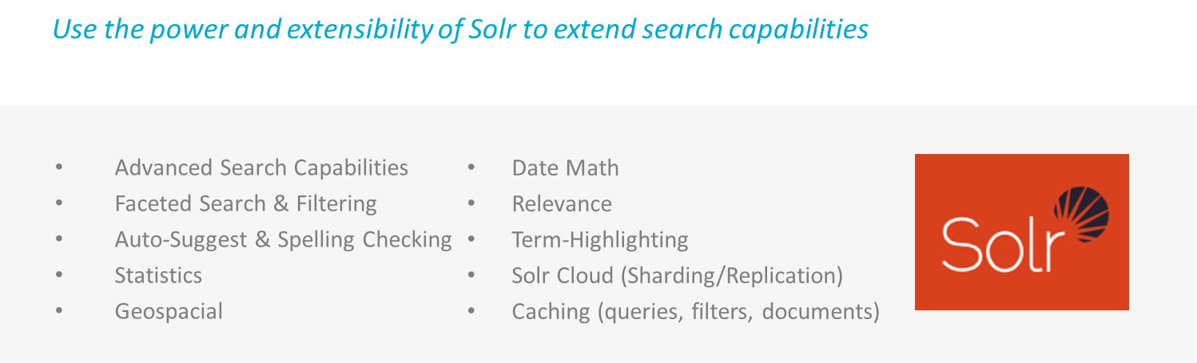
ACS Capabilities - Extensible search with Solr

Slide 21
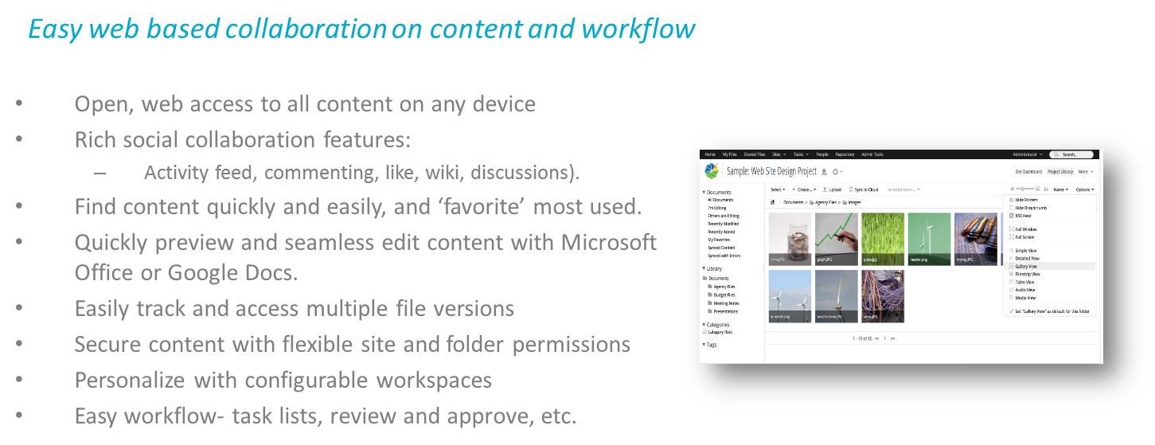
ACS Capabilities - Share & collaboration

Slide 22
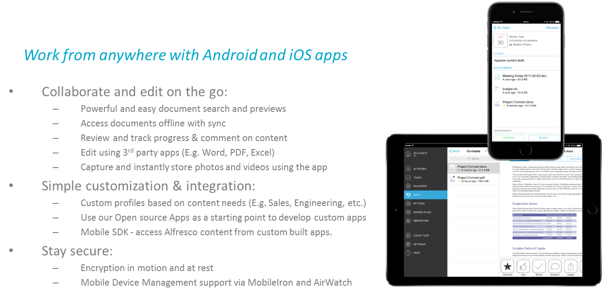
ACS Capabilities - Open Mobile apps

Slide 23
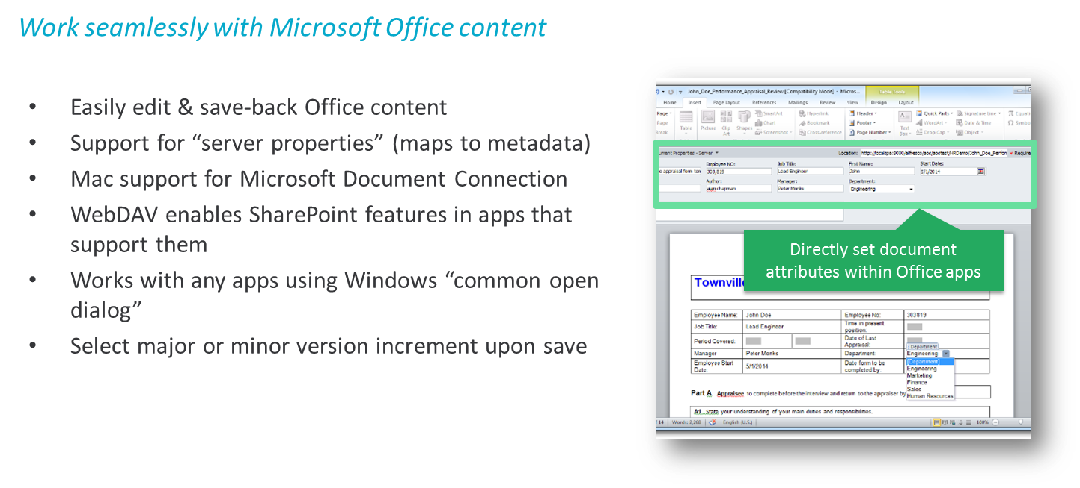
ACS Capabilities - Alfresco Office Services

Slide 24
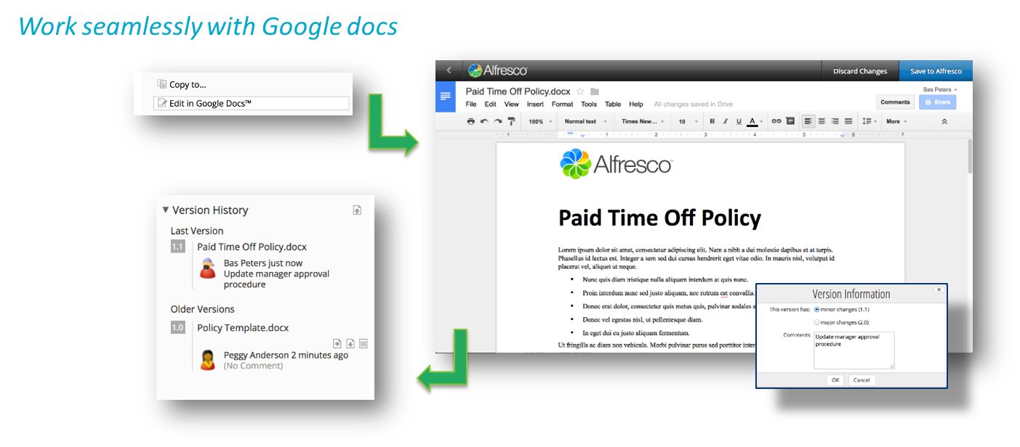
ACS Capabilities - Google docs integration

Slide 25
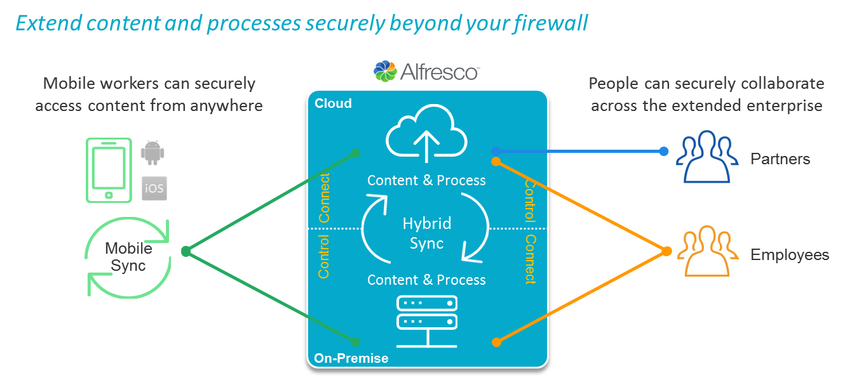
ACS Capabilities - Hybrid Cloud Sync

Slide 26
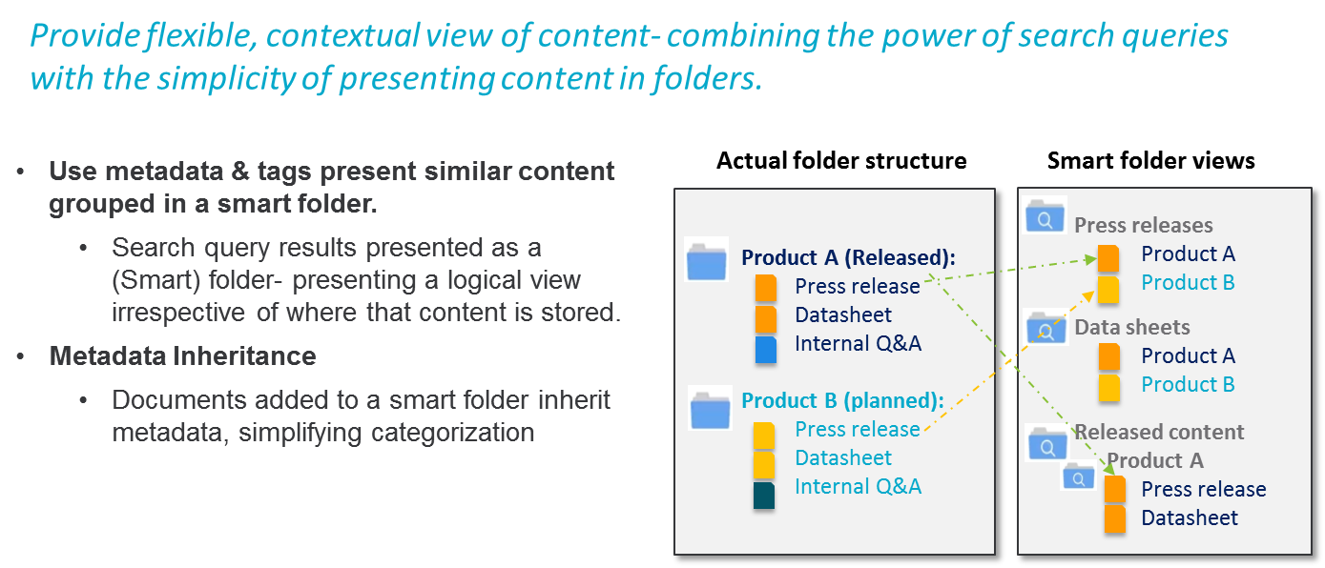
ACS Capabilities - Smart Folders

Slide 27
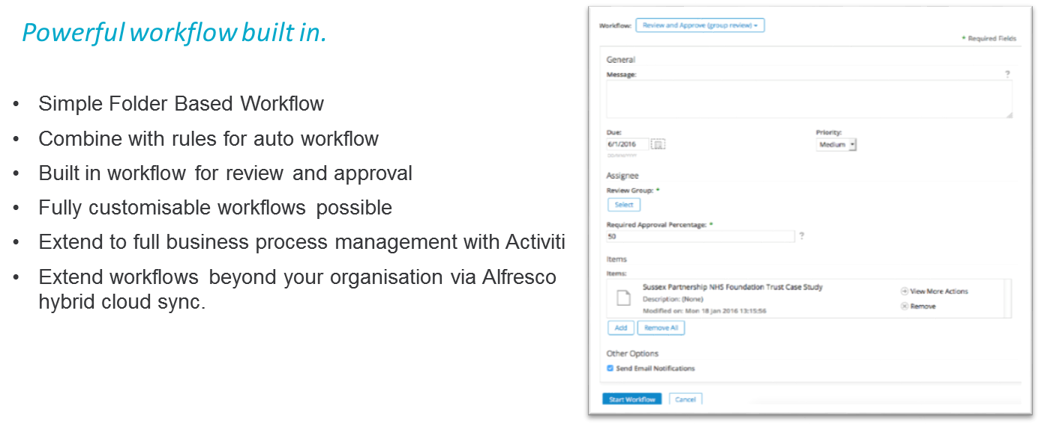
ACS Capabilities - Workflow

Slide 28
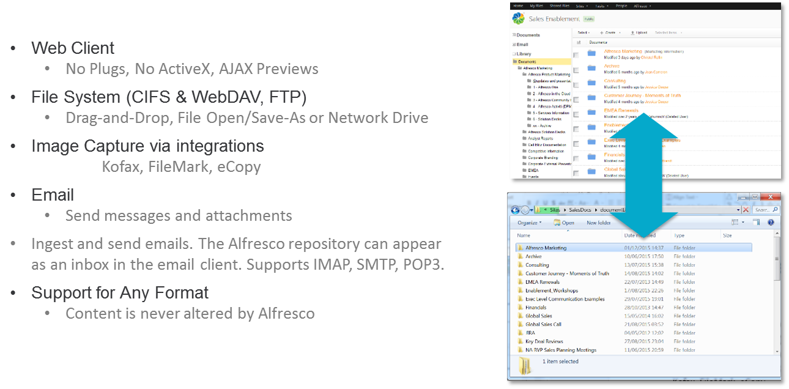
ACS Capabilities - Information Capture & display

Slide 29
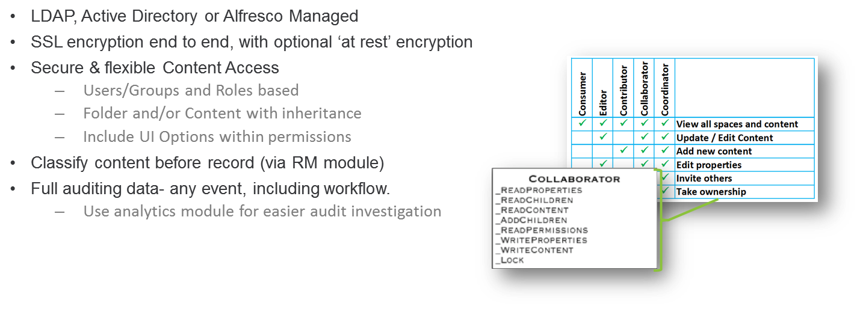
ACS Capabilities - Security & Auditing

Slide 30
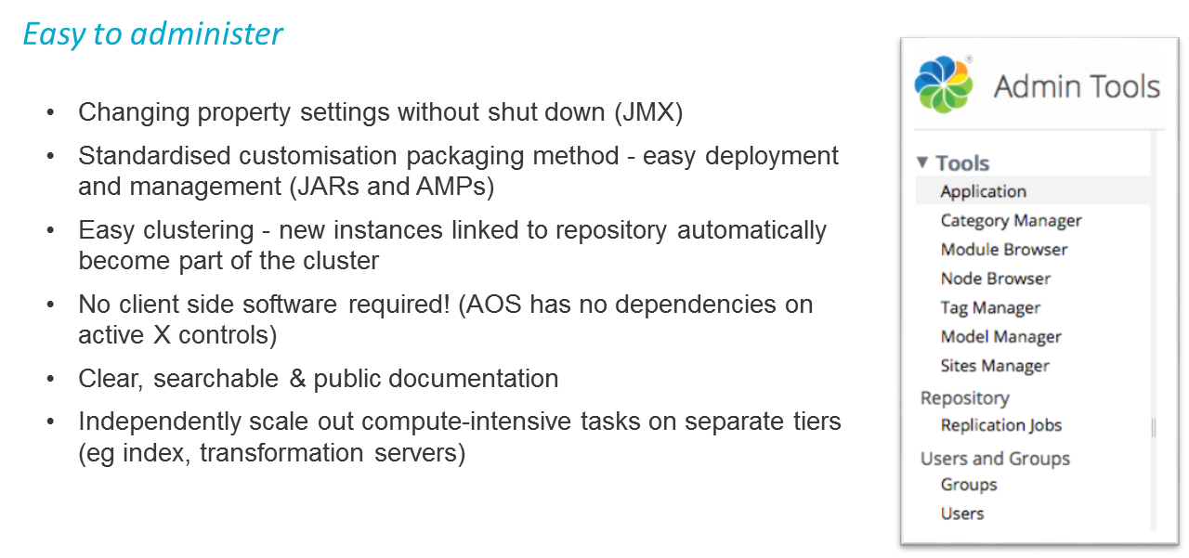
ACS Capabilities - Easy Administration

Slide 31
ACS Modules
Alfresco Governance Services
Media Management
Analytics
Outlook plug-in
Document Transformation Server
Index Server
Content Encryption
Alfresco System Receiver (ASR)
AWS & EMC Centera Connector

Slide 32
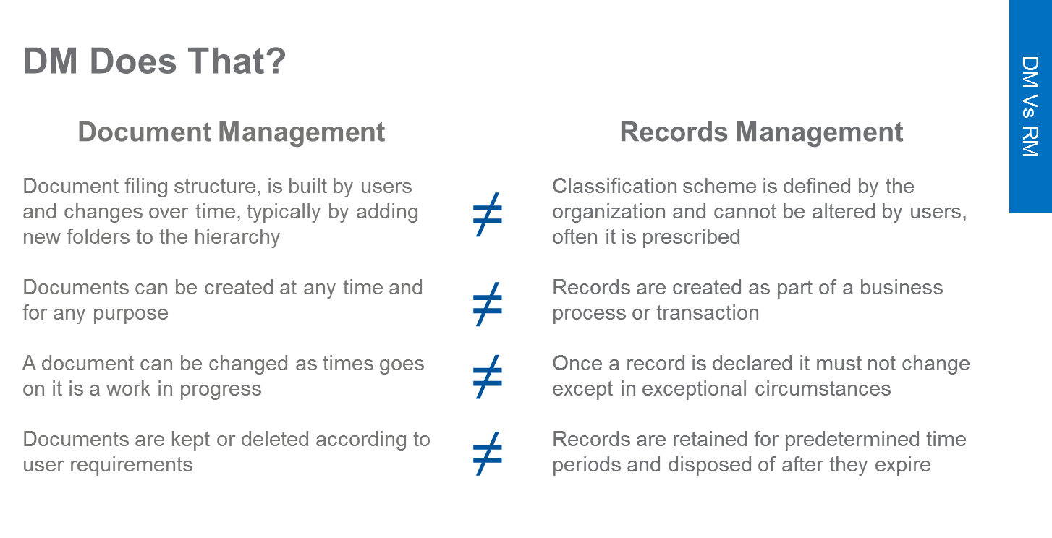
Document Management vs Records Management

Slide 33
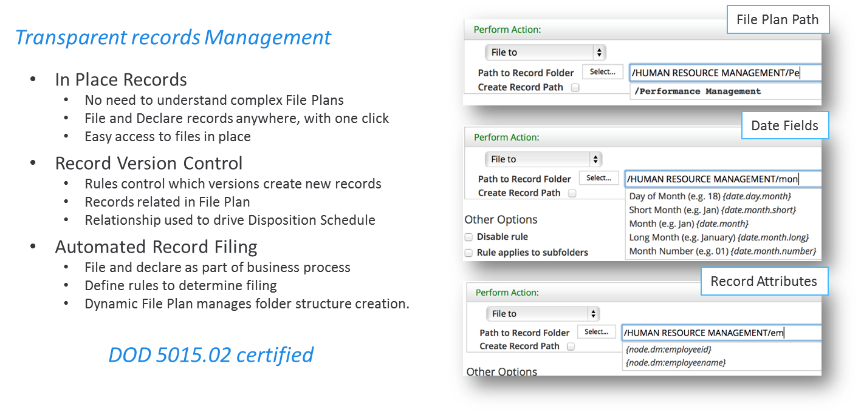
ACS Modules - Alfresco Governance Services

Slide 34
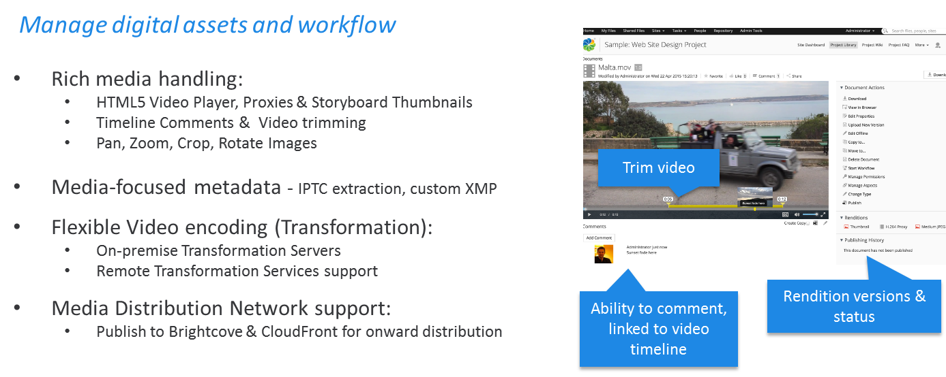
ACS Modules - Alfresco Media Management

Slide 35
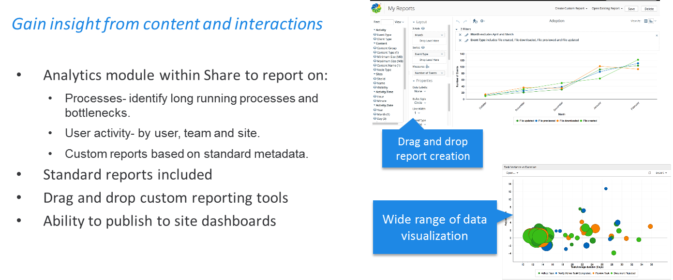
ACS Modules - Alfresco Analytics

Slide 36
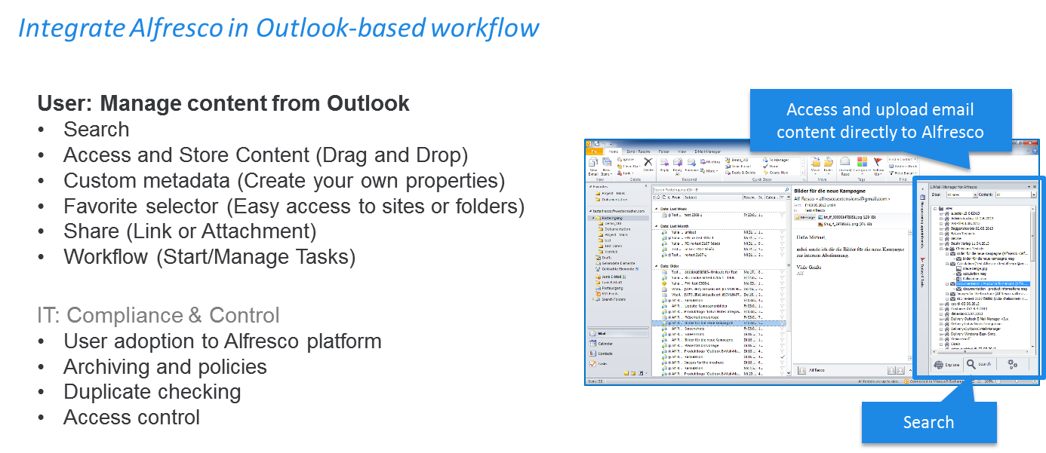
ACS Modules - Microsoft Outlook Plug-in

Slide 37
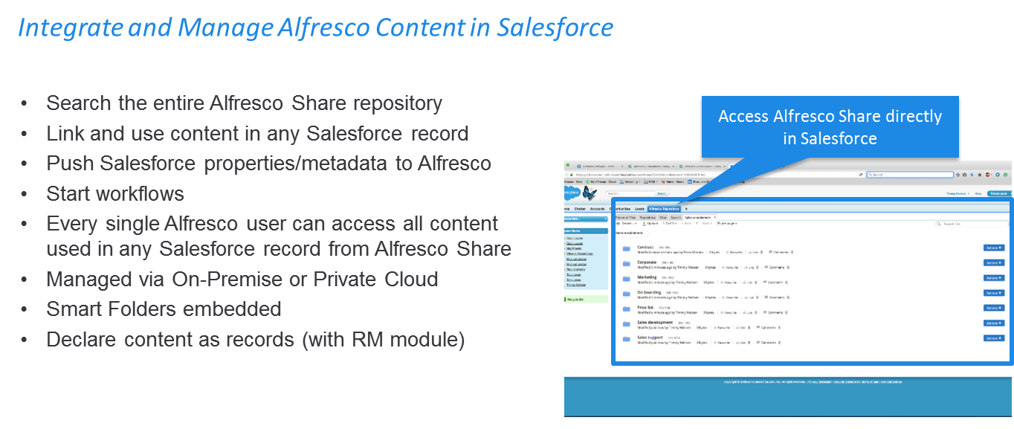
ACS Modules - Content Connector for Salesforce

Slide 38
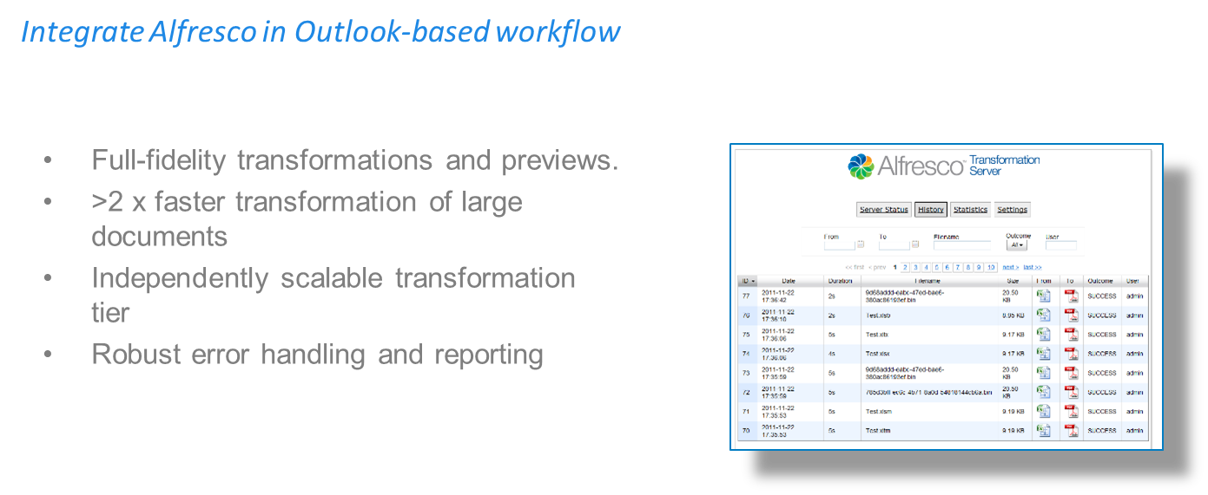
ACS Modules - Document Transformation Server

Slide 39
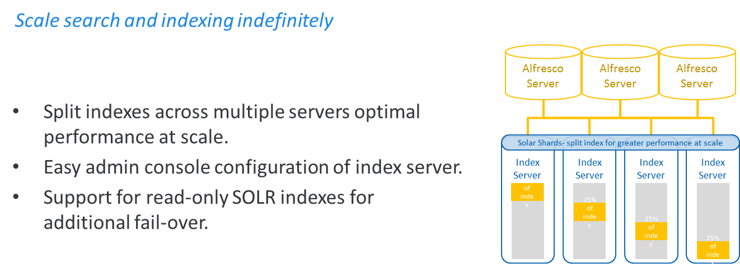
ACS Modules - Index Server

Slide 40
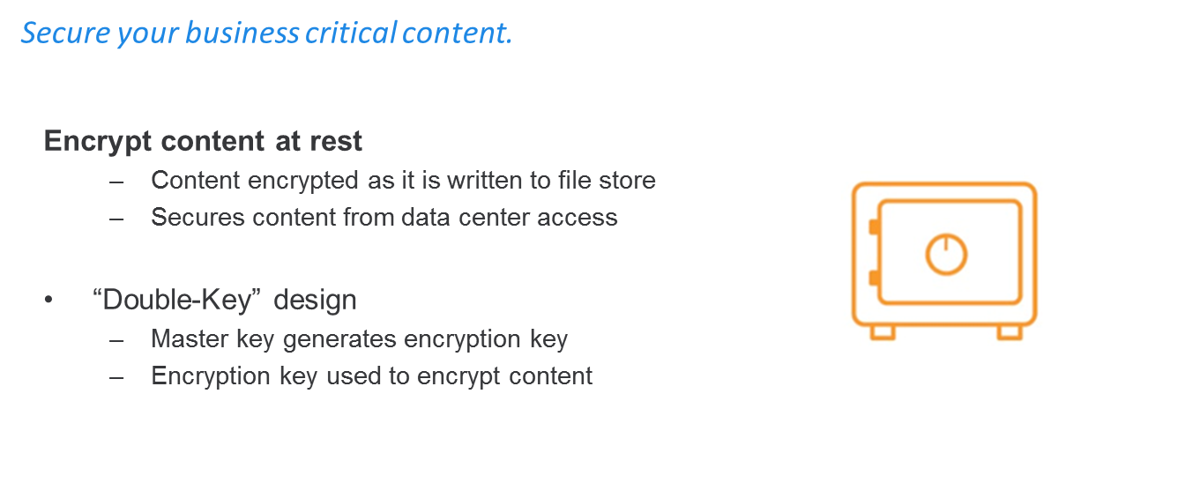
ACS Modules - Content Encryption

Slide 41
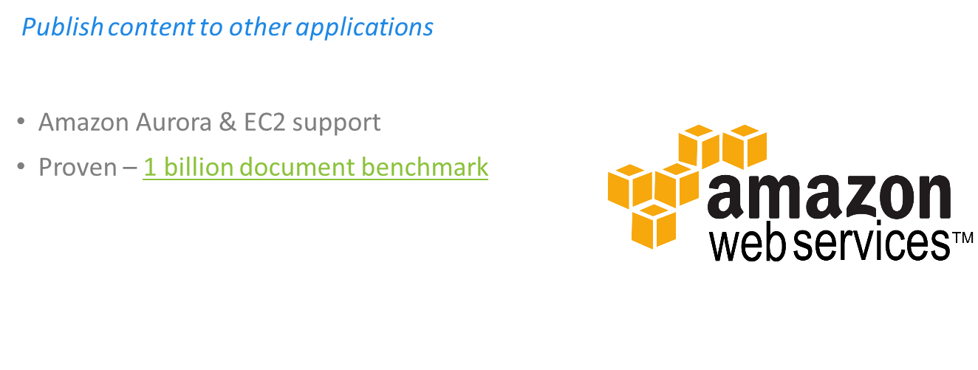
ACS Modules - Amazon web services

Slide 42
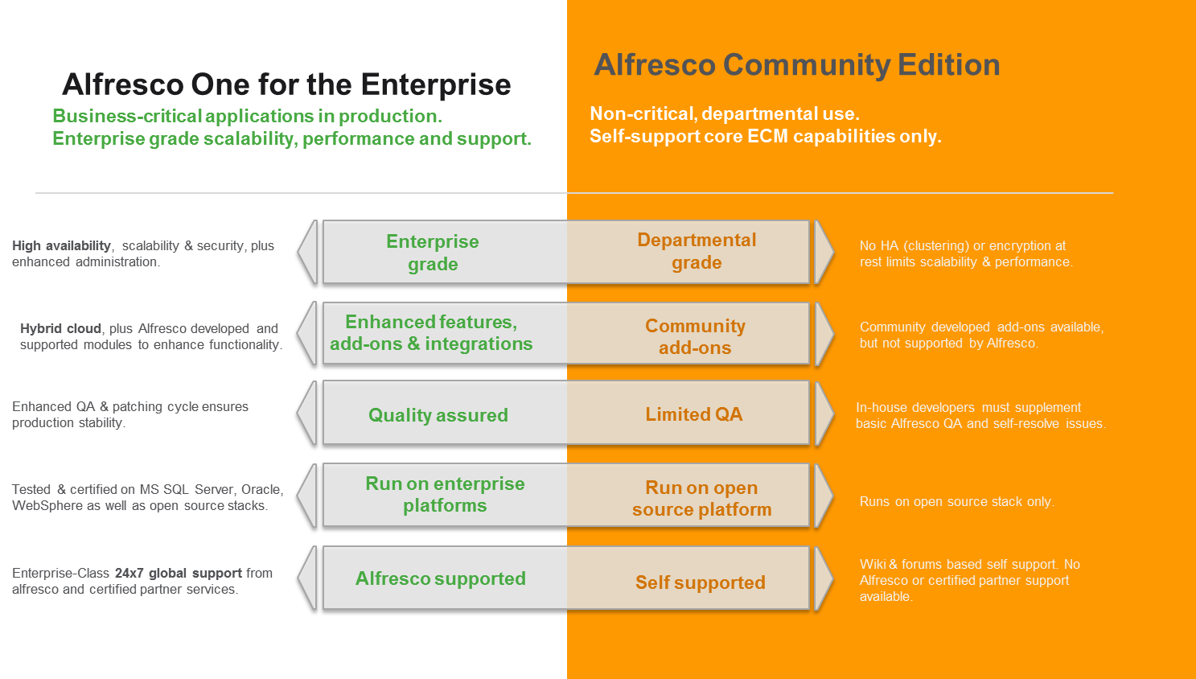
Alfresco Enterprise vs Community

Slide 43




Alfresco Process Services
Edit Master text styles
Edit Master text styles
Edit Master text styles
Edit Master text styles
Ease of Development & Deployment
Powerful Task Management
Open & Easy to Integrate
Addressing Process Compliance
Enterprise Scale & Robustness
Notes:
Ease of Process Definition Development & Deployment
Provides a suite of user-friendly tools that make it easy to model, deploy and update critical business processes.
Graphical tools like the Step Editor guides business users to quickly and easily create new process models.
BPM analyst can use the powerful BPMN Editor for advanced and powerful process modeling
Powerful Task Management
Users to access all information, tasks and documents to quickly and efficiently complete key business processes
Collaboration with users working as a team to complete tasks. Users can allocate tasks and subtasks to individuals, allowing users to address non-routine tasks
Group and individual tasks inboxes allow organizations to model processes to support a wide range of business scenarios
Open, Easy to Integrate & Extend
Support for industry standards (such as BMPN 2.0, and DMN) allow process architects to easy migrate existing process to the Alfresco platform
Java-based process engine and support for open API's makes integrating and extending effortless
A modern, REST-based, architecture makes Alfresco Process Services the platform of choice to orchestrate processes across multiple business applications
Addressing Process Compliance
Tight integration with Alfresco Content Services allows processes to drive compliance and records activity.
Automated document creation and declaration, with the ability to save process history, enables organizations to automate many of the time consuming activities associated with meeting strict compliance needs
Extensive integration with other line of business applications and content sharing systems (i.e. Box and Google Drive) enables Alfresco Process Services to capture casual content and put it under compliance control
Enterprise Scale & Robustness
Powerful process analytics provides tools to review, analyse and optimize processes to ensure that they are complete as efficiently as possible
Advanced architectural design allows Alfresco Process Services to grow and scale to meet your company’s needs
Advanced support for clustering of process engines provides a robust platform to ensure no system outage or application down time

Slide 44
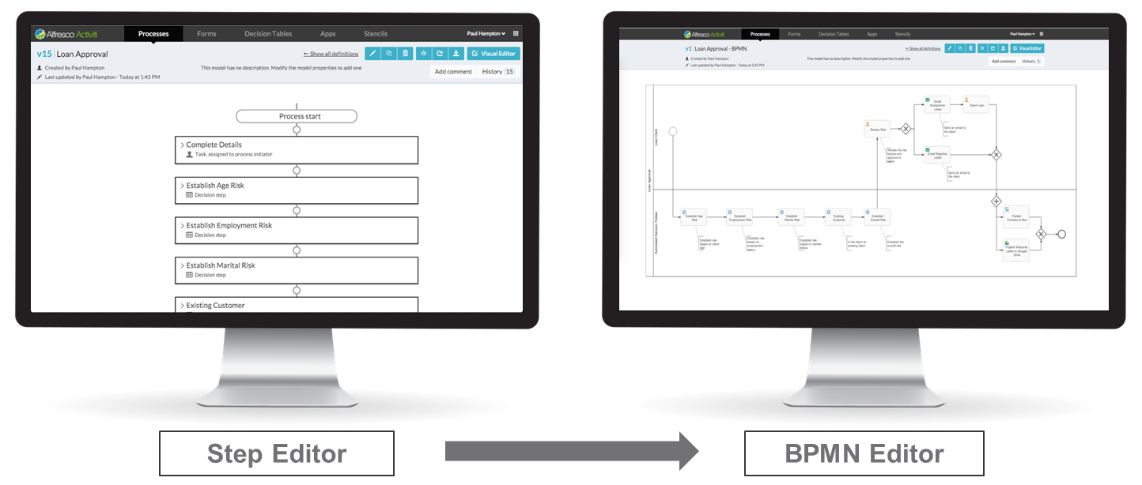
APS – Process Editor

Slide 45
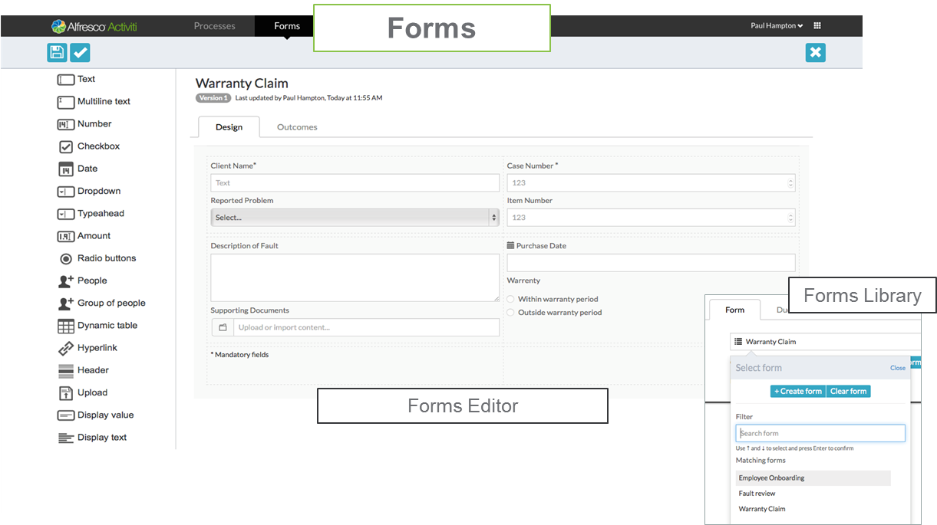
APS - Forms Editor

Slide 46
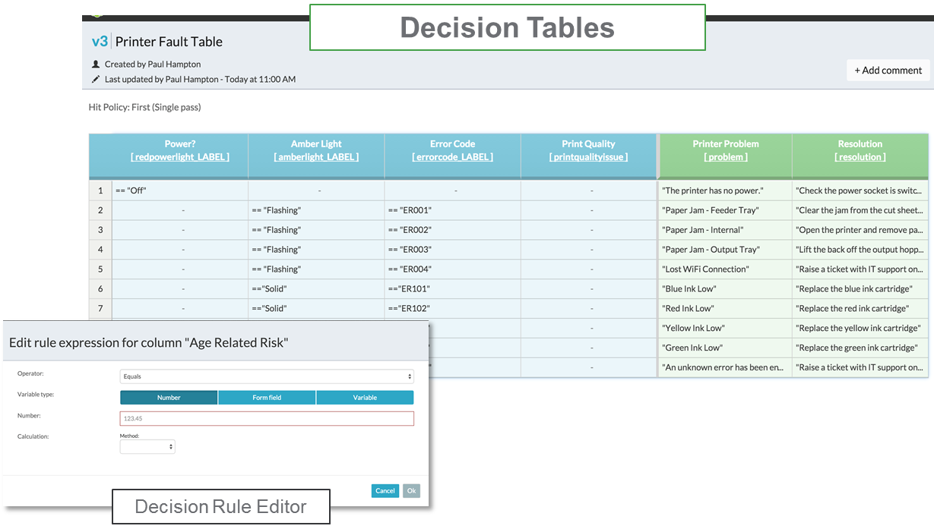
APS – Decision Tables

Slide 47
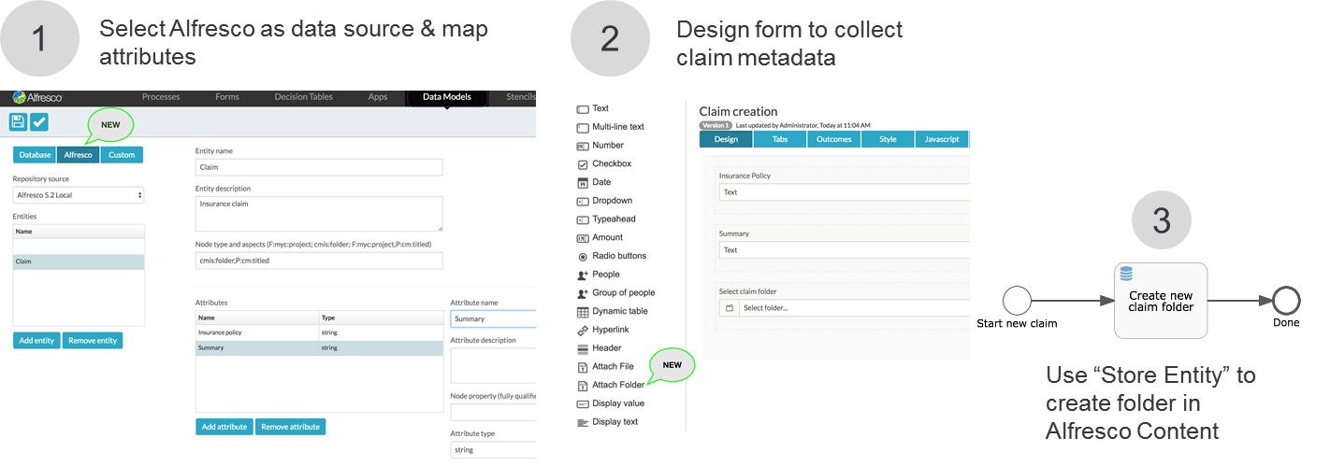
APS – Data Models

Slide 48
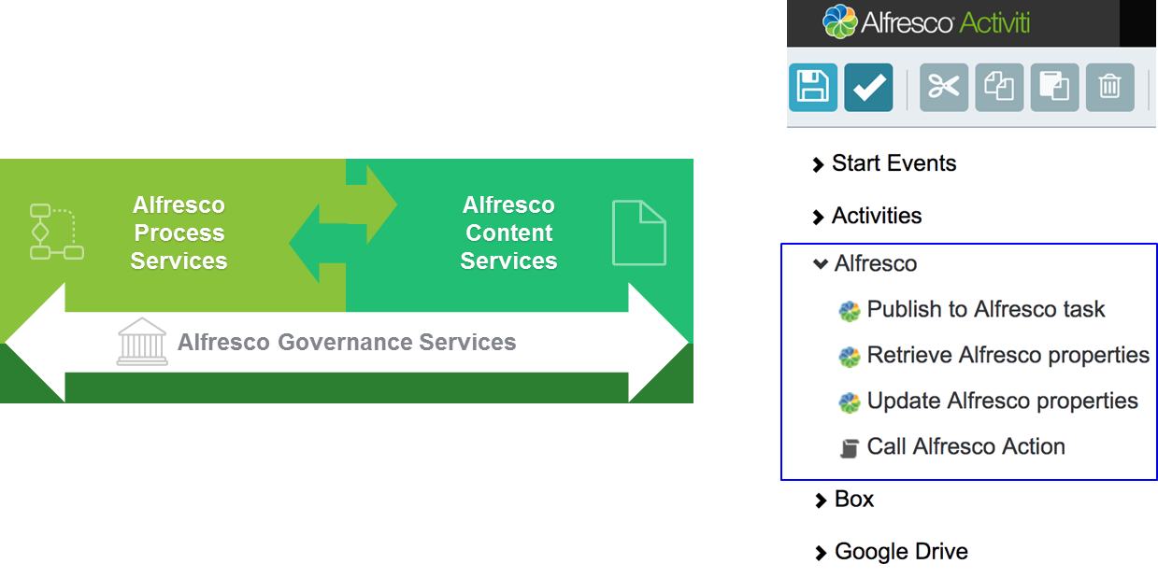
APS – ACS integration

Slide 49
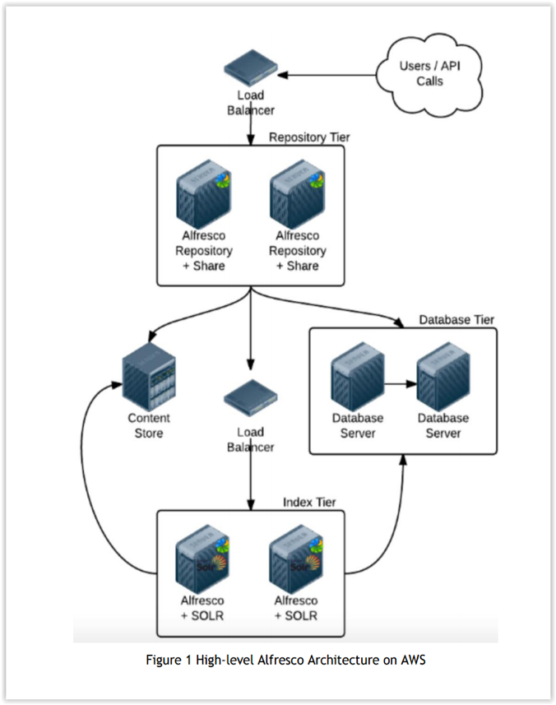

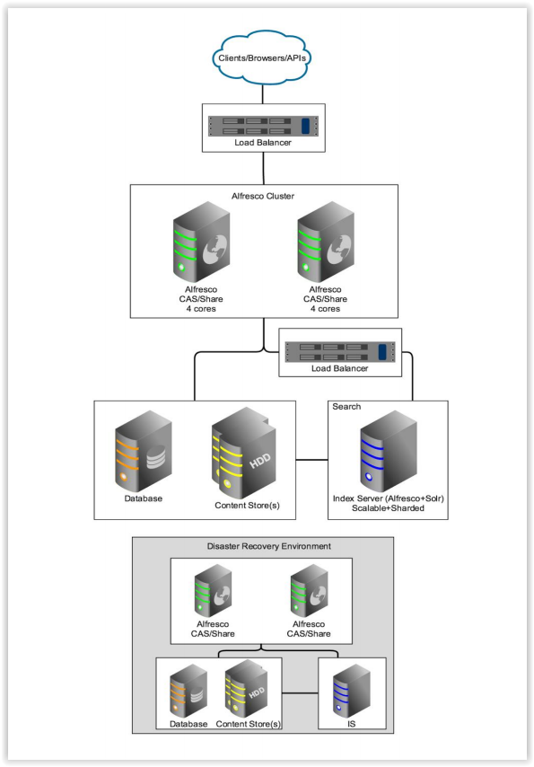

Alfresco Deployment
On-Prem

Slide 50
Alfresco Technologies Used
Apache Chemistry | CMIS AtomPub binding and Abdera CMIS Extension for Web Services binding
Apache Commons | A lot of the commons libraries are used such as Codec, Lang, File Upload, HTTP Client
Apache PDFBox | Document transformations
Apache POI | Access Microsoft Office documents
FreeMarker | Presentation templates
iBATIS | SQL mapping layer
Activiti | Workflow engine
Lucene & Solr | Indexing and searching
OpenOffice | Transforming office documents to text
Mozilla Rhino | Server-side JavaScript engine
Spring | Dependency Injection (DI) component container
Spring Security | Used for authentication and method-level authorization

Slide 51
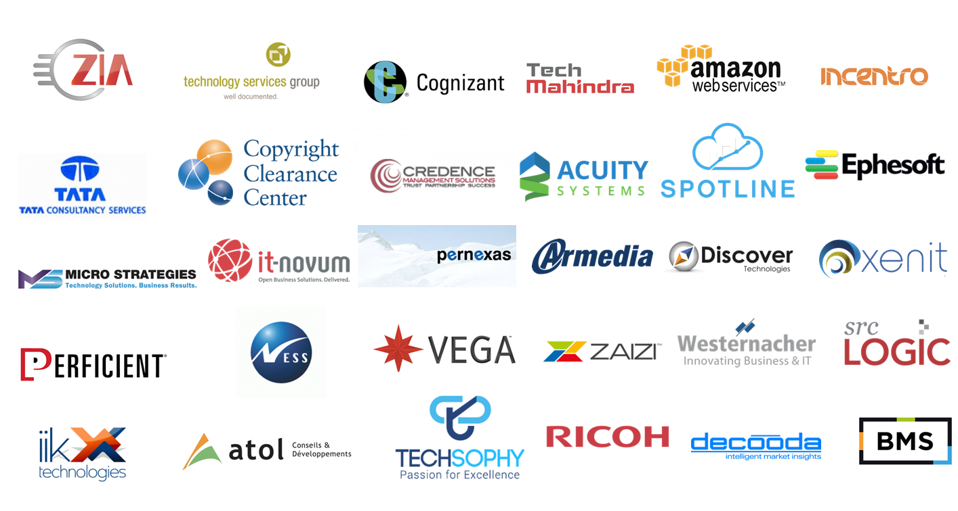
Alfresco Partners

Slide 52
Thank you

